Slide 1
CHAPTER 1 : LEARN TO LEARN
ASK
QUESTIONS

Slide 2

OBJECTIVES FOR THIS SESSION
What is the good behavior to ask a question ?
What is a good, and a bad question ?

Slide 3

If you don’t Ask, Don’t Get

Slide 4


ACTIVITY
ACTIVITY 1
10 MIN
Before you ask a question…
Open the Google Form
Choose whether the questions are good or not
Discuss the reasons of your choices

Slide 5




Before you ask a question…
I will ask my teacher this question during the next session
PLAN IT
KNOW THE GOAL
Teacher, after reviewing my notes, I don't understand what is a web application
DON’T WAIT
Teacher in your last slide what is the meaning of RAM ?

Slide 6
ACTIVITY
ACTIVITY 2
10 MIN
When you ask a question…
Open the quiz
Choose whether the questions are good or not
Discuss the reasons of your choices

Slide 7


When you ask a question…
What is the shortcut to open File explorer ?
It s WINDOWS + E
CLEAR
OPEN-ENDED
Why do we need to use shortcuts ?
Because you will work faster with your computer
SHORT
How can computer keep the data?
Data are stored on files.
A disk can store files even when computer is switched off

Slide 8
QUIZ
ACTIVITY 3
10 MIN
QUIZ !
Open the quiz
Are those questions following the good questions rules ?

Slide 9
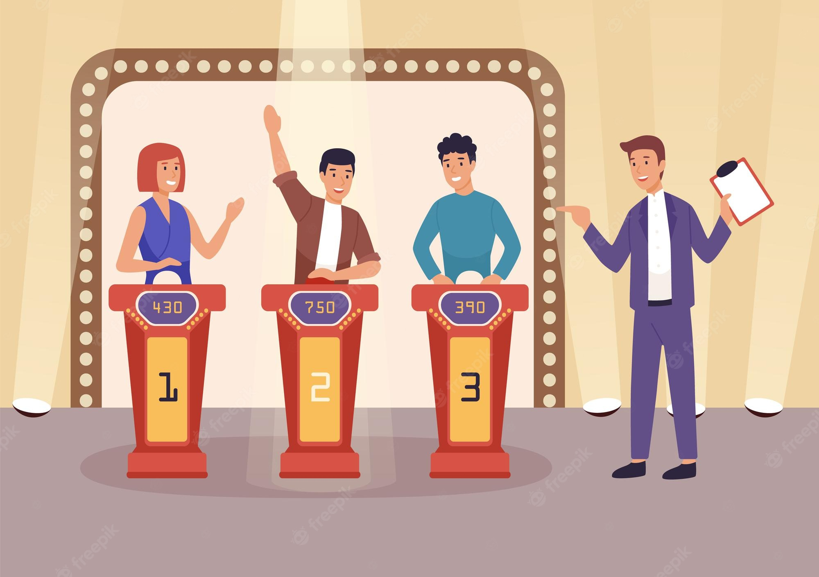
QUESTIONS
GAME !

Slide 10
ACTIVITY
ACTIVITY 4
10 MIN
Find a question !
Yellow
We give you an answer :
What is the color of the banana?
Find a question that matches :
1
2
2
READ THE ANSWER
FIND AN ANSWER ON PAPER
SHOW YOUR ANSWER TO YOUR TEAM AND VOTE

